Slide 1
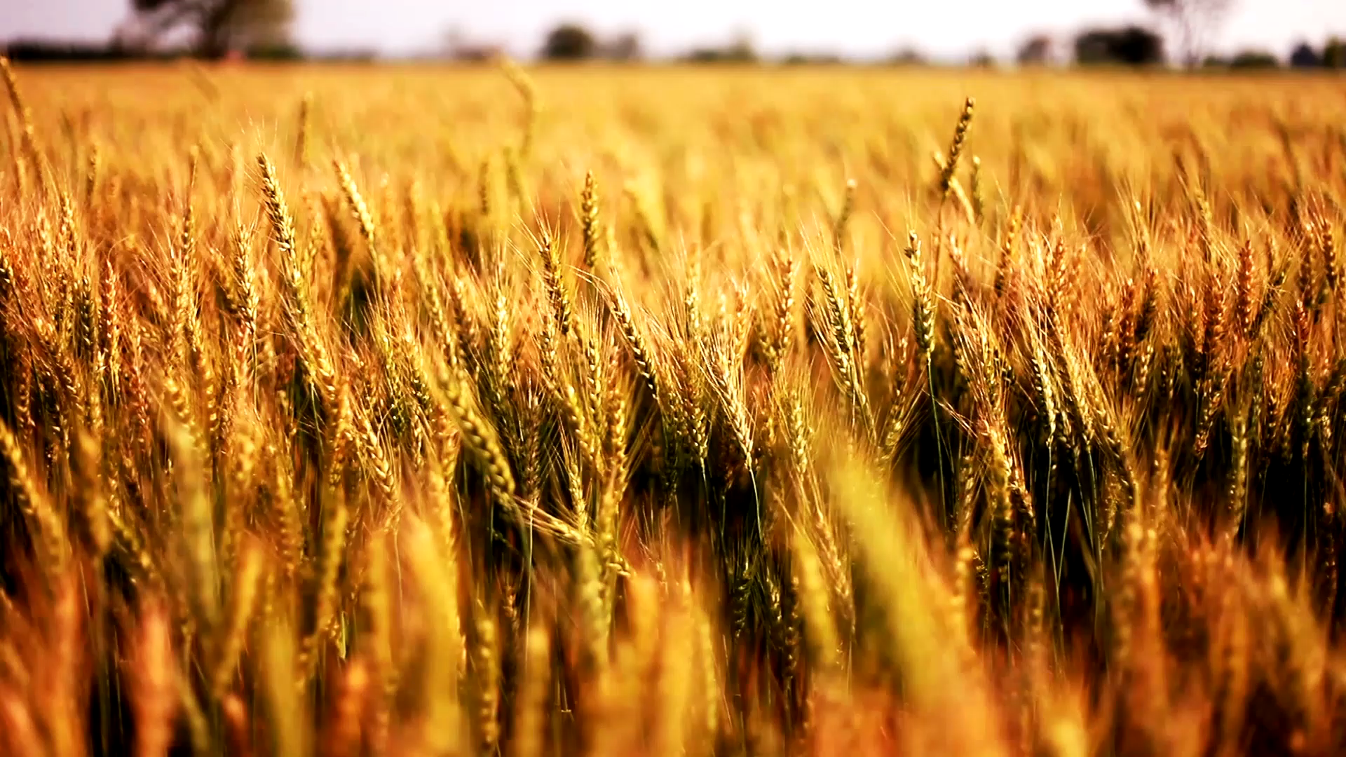
Brewing Data Final Analysis
Featuring:
Danne Paredes
Prateetya Bajracharya
Seth Abbott

Slide 2
Ain’t no laws when you’re drinking claws
Originally, our group had planned to compare the amount of laws sold per year to the debut year of white claw (2016) and the following years after. Unfortunately, we could not locate sales data on white claw without paying a great deal of money
After finding a great API with tons of beer and brewery data for only $20, we decided to modify our project to examine the potency of beers, the amount of styles each brewery makes, and what percentage of beers are organically produces
After we modified our project, we were able to successfully answer most of our questions. Most importantly we learned that ABV and IBU are positively correlated. We were not able to locate accurate data on organic beer trends over time.

Slide 3
Telling a story with data
We sourced 100% of our data from the “brewerydb” API key that we purchased a key for $20. Questions we asked were as follows:
What brewery brews the most different styles of beer?
Which breweries tend to make beers with the highest ABV? Highest IBU?
Is there a correlation between ABV and IBU? What percentage of beers are organic? Has the percentage been increasing or decreasing over time?
Which beers have the highest IBU? Highest ABV?
We hypothesized that there would be a strong positive correlation between IBU and ABV and that IPA’s would be the style of beer that had the highest ABV and IBU.

Slide 4
Data Cleanup
Our API required us to pull brewery data one by one, so we chose ten popular breweries to analyze. When we pulled the data into a pandas dataframe, it didn’t have a column for “brewery name” so we added one and populated it with the name of the corresponding brewery. We then took all ten brewery dataframes and combined them using append.
We also pulled a large random sample of individual beers and loaded that into a data frame as well.
We had pandas list the column values of the dataframes, and we dropped all columns that we were confident we would not want to examine from both the total breweries dataframe and the beers dataframe.
We exported the clean data to csv for data analysis.

Slide 5
Data analysis
Our analysis portion was fairly straightforward due to all of our research questions being designed to be easily quantifiable.
We were unfortunately not able to locate accurate data on the amount of organic beers produced per year.
We have did 8 graphs for the project including: 4 bar graphs, 2 box plots, regression analysis, and pie chart.
We used both matplotlib and pandas to create the visualizations.

Slide 6
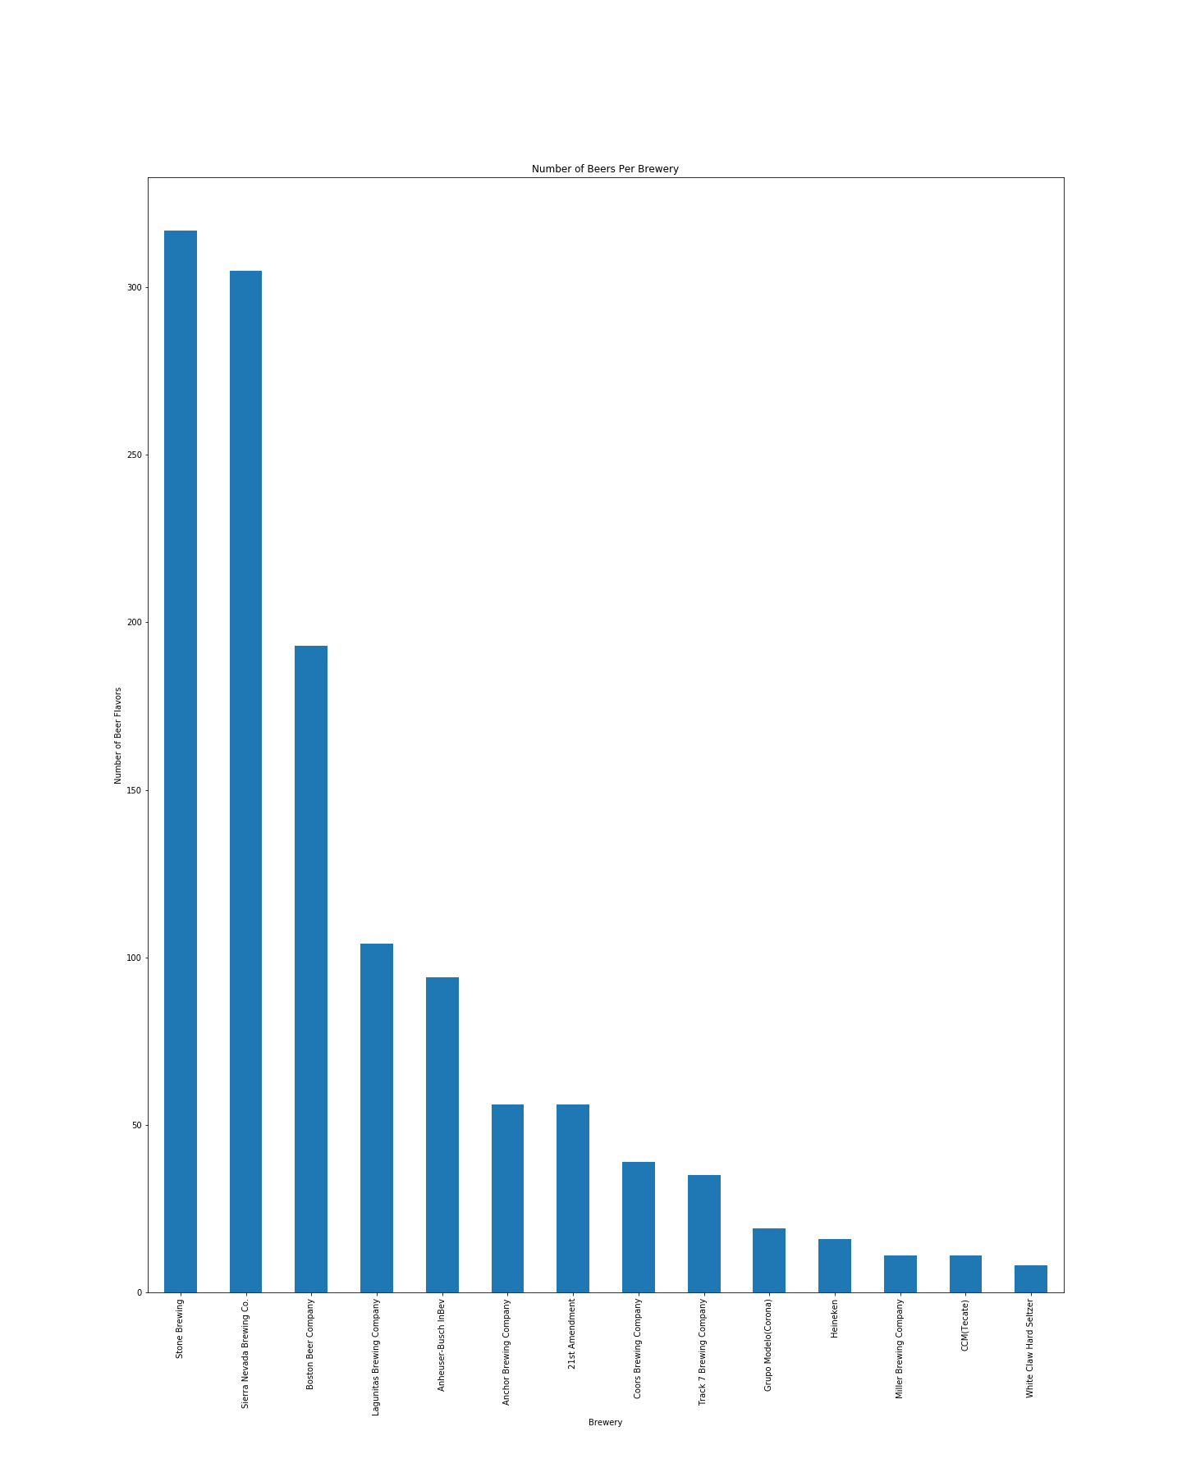
Number of beer varietals per brewery

Slide 7
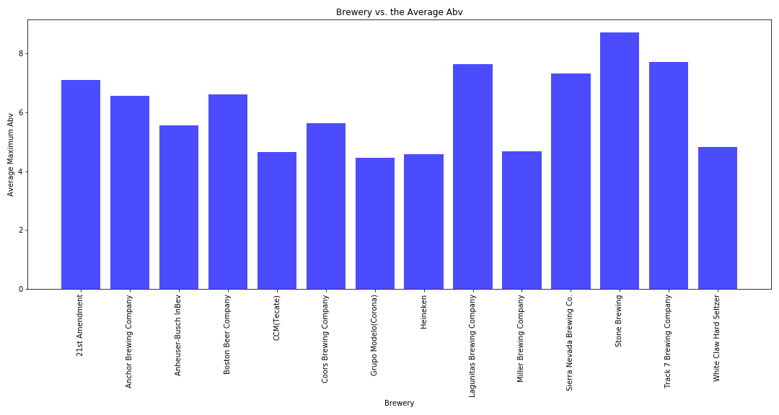
Average Maximum abv per Brewery

Slide 8
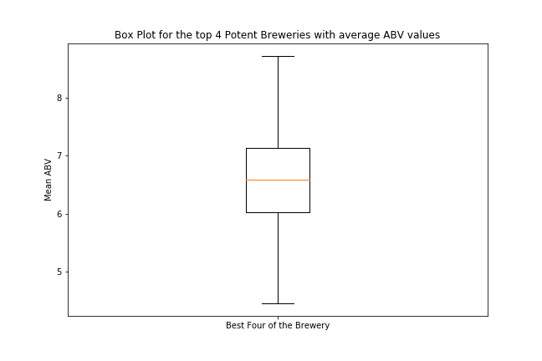
Distribution of Max ibu values per brewery

Slide 9
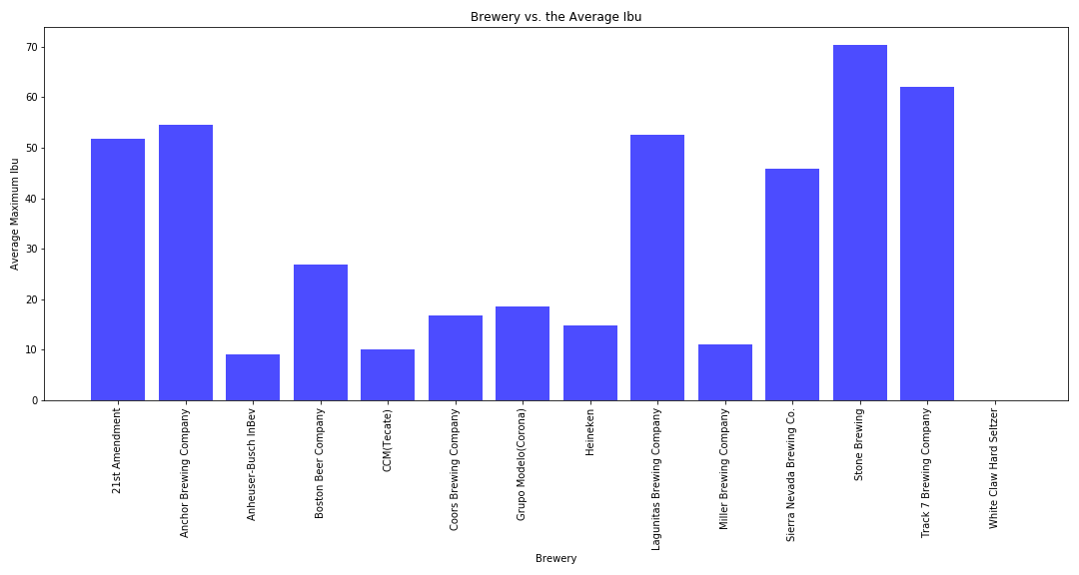
Average Maximum ibu per Brewery

Slide 10
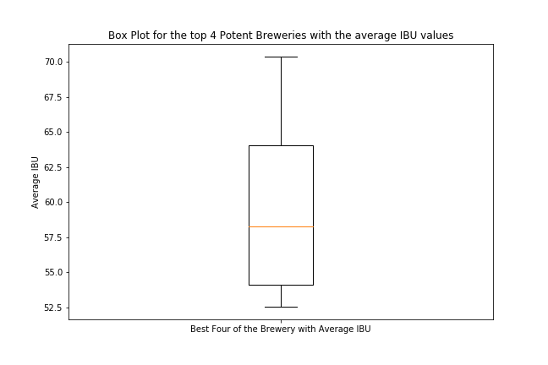
Distribution of Max ibu values per brewery

Slide 11
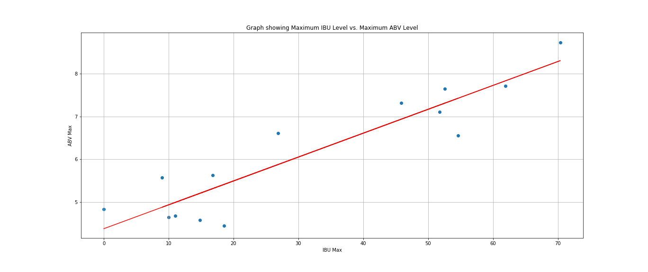
Max abv vs. Max Ibu: strong Positive correlation

Slide 12
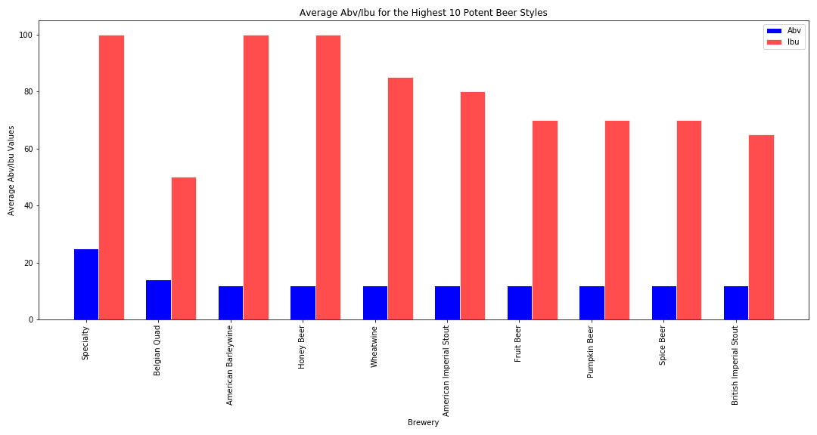
Most Potent styles of beers: Abv and abu averages

Slide 13
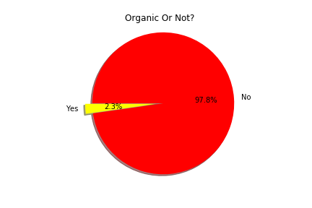
Percentage of beers that are organic

Slide 14
Post mortem
So finding the data was difficult, We were not able to find anything on sales so our initial goal was unobtainable(How the introduction of ‘Hard Seltzers’ impacted the sales of beer and alcohol). From there we changed to an ABV/IBU analysis so the next struggles were working with the API.
It only gave us one beer at a time and the documentation was not very helpful but with some help from the TA’s, we were able to work our way through it and I figured out how to call everything all at once (don’t forget to space out your API Calls lol).
If we had more time, we would have done all of the beers on the site (Over 100k!) but because of API call limits(200 per day) we could only get through about 2k per day so it was not feasible to do that. Instead we went to a sample size and split it up by popular breweries

Slide 15
Discussion
Most of our findings didn’t necessarily surprise us. Our hypothesis that there would be a strong positive correlation between ABV and Ibu was correct.
However, our hypothesis that IPA’s would be the most overall potent style was not correct. Specialty beers, Belgian ales, and stouts tended to be the most potent.
Craft breweries tended to have more styles, mainly because the tend to modify recipes yearly and re-release beers with slight modifications.
Of our random sample of beers, organic beers made up a very small portion.
Track 7 Brewing Company and Stone Brewing Company tends to create the beers with the highest levels of ABV and IBU

Slide 16

Special tribute to our fallen teammate: Angel e. moreno 3/31/20 – 5/18/20 Gone but never forgotten

Slide 17
Questions? Compliments? Crticism?
Speak your mind! We are happy to answer anything!

